Slide 1

SOCHE Hearing Officer Training with Erin Butcher and Jessica Galanos, Bricker & Eckler LLP
November 4, 2022

Slide 2
Disclaimer
Change is constant in this field.
Expect new guidance and case law to be issued regularly after this training.
Check with legal counsel regarding specific situations in light of the dynamic nature of requirements.

Slide 3
Posting These Materials
Yes, you have permission to post these materials on your website as required by 34 C.F.R. 106.45(b)(10)(i)(D).

Slide 4
Today’s Agenda
Values Exercise
Annual Clery Review
Review of Scenario
Review of Roles
Planning Questions for Parties and Witnesses
Questioning Parties and Witnesses
Debrief
Making a Good Decision
Writing the Decision
Deciding Our Case!

Slide 5
Values Exercise
What are the top three values that are fundamental to your Title IX process? (one word each)
What is the most important thing we want students to take away from our Title IX process? (three words or less)
You have 90 seconds. Go.

Slide 6
Institutional Ethic of Care
The values you build into your investigative/adjudicative procedures
The values you build into your community
The way you treat members of your campus community
The way you expect members of your campus community to treat each other

Slide 7
Overarching Themes (1)
“Follow your policies. Follow your process.”
Monitor the emotional temperature of the case.
Provide regular updates.
  “If they don’t hear from you, they’ll assume that you’re doing nothing or actively working against them.”
Be mindful of any language that might suggest predetermination (e.g. perpetrator, victim).
Notes:
This regulation will be effective August 14, 2020

Slide 8
Overarching Themes (2)
Base decisions on evidence, not your “gut.”
Individuals under pressure are constantly “reading the tea leaves.”
  Transparency encourages participation, reduces stress, and increases trust in the outcome.
  “Never miss a chance to be transparent.”
Notes:
This regulation will be effective August 14, 2020

Slide 9

Annual Clery Training Review
Sexual Assault, Dating Violence, Domestic Violence, Stalking

Slide 10
Data and Statistics
Should not influence your decision in any particular Title IX case
Included in the Preamble, but with caveats
We didn’t do the research ourselves – surveys and data collection techniques are available for each cited work.
Okay but really, this SHOULD NOT influence your decision in any particular Title IX case
9
Notes:
As many of you know, the Clery Act regulations require annual training on issues related to dating and domestic violence, sexual assault, and stalking (34 CFR 668.46(k)(2)(ii). Most, if not all, of the trainings I’ve attended include data and statistics on these subjects because it can help provide much-needed context for these issues (for example, helping to identify barriers to reporting).
However, we have to include more disclaimers here because we want to make sure that this information is used appropriately.
Data and Statistics should not influence your decision in any particular Title IX case. So, for example, if you’ve read that as many as one in four women or one in five women experience attempted or completed sexual assault while in college – do not assume that one out of every four or five SA cases on your desk has to result in a finding that sexual assault is more likely than not to have occurred. If you do this, you are allowing data and statistics to influence your decision in particular cases, which is NOT the reason we are providing this information.
We should note that the Preamble to the Final Title IX regs references statistics in several places, primarily on pages 30075 to 30082, but with some pretty significant caveats, which we’ll get to in a moment.
Also, we didn’t do this research ourselves, and cannot vouch for its accuracy. We’ve included citations to the various studies, and to the Preamble which includes citations, so if you are particularly interested in something, please go directly to the source to review it.
And finally, “Ok but really, data and statistics SHOULD NOT (all caps) influence your decision in any particular Title IX case. We believe this point is important enough that it gets 2 bullet points from us.

Slide 11
Sexual Assault Data
Women and Men
More than 1 in 2 women and 1 in 3 men have experienced sexual violence involving physical contact during their lifetimes.
1 in 4 women and about 1 in 26 men will experience completed or attempted rape during their lifetimes.
Nearly 1 in 9 men was made to penetrate someone (completed or attempted) during his lifetime.
Statistics from CDC.gov/violenceprevention/sexualviolence/fastfact.html (last accessed October 29, 2022)

Slide 12
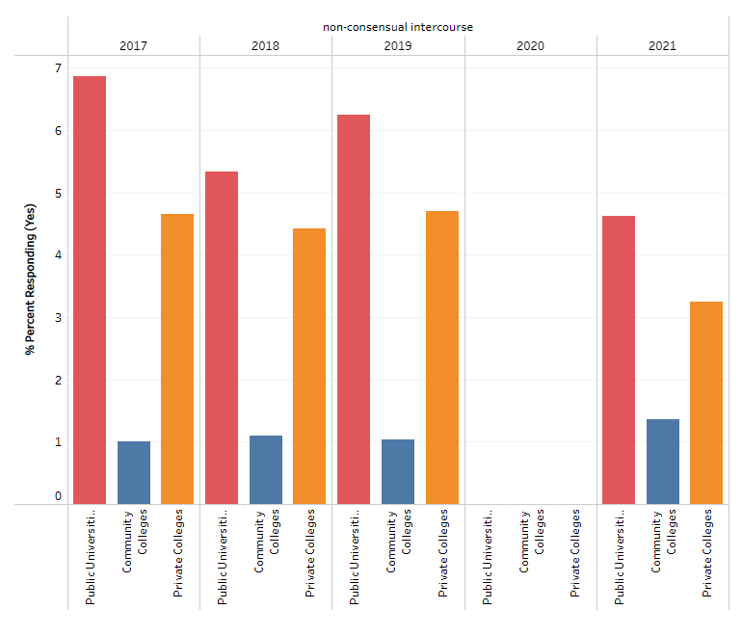
Sexual Assault Data
ODHE Survey – Non-Consensual Intercourse
Statistics from ODHE Changing Campus Culture Benchmark Data (last accessed October 25, 2022)

Slide 13
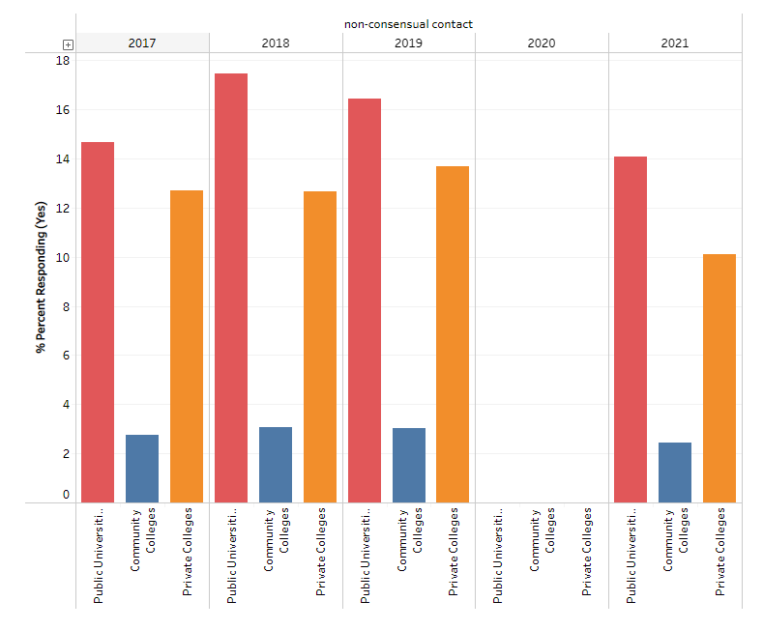
Sexual Assault Data
ODHE Survey – Non-Consensual Contact
Statistics from ODHE Changing Campus Culture Benchmark Data (last accessed October 25, 2022)

Slide 14
Sexual Assault Data:
Identity of Perpetrator (BJS 2014)
Preamble, p. 300767(Official) notes that “Commenters cited: U.S. Dep’t of Justice, Office of Justice Programs, Bureau of Justice Statistics Special Report: Rape and Sexual Assault Victimization of College Age Females, 1995-2013 (2014).
13
Notes:
This data comes from “Rape and Sexual Assault Victimization of College Age Females, 1995-2013”, issued in December 2014 by the Bureau of Justice Statistics, and is likely information that you recognize from your own experience working in the area of Title IX. Perpetrators of sexual assault typically are not strangers; this study showed that 78% of sexual assaults against female students were caused by perpetrators known to them, with that percentage being slightly higher (80%) for non-students. It is far more likely that the perpetrator will be a friend, roommate, or someone else known to the victim.

Slide 15
Sexual Assault Data: Timing
Prevalence Data for Postsecondary Institutions
More than 50 percent of college sexual assaults occur in August, September, October, or November, and students are at an increased risk during the first few months of their first and second semesters in college.
Preamble, p. 30076 (Official) notes that “Commenters cited: Rape, Abuse & Incest National Network (RAINN), Campus Sexual Violence: Statistics, https://www.rainn.org/statistics/campus-sexual-violence.”
14
Notes:
I think that for many of you who are already working in Title IX at a college or university – this statistic may not be surprising to you.
According to RAINN, more than half of all sexual assaults in college occur during the first semester, and students tend to be at a greater risk during the first few months of their first and second semesters in college.

Slide 16
Sexual Assault Data:
Alcohol/Drug Use
“About half of sexual assaults involve survivors drinking alcohol before the assault.”
“Survivors impaired by alcohol are more likely to disclose to informal, but not formal support sources than are non-impaired victims.”
Lorenz, Katherine, and Sarah E Ullman. “Exploring Correlates of Alcohol-Specific Social Reactions in Alcohol-Involved Sexual Assaults.” Journal of aggression, maltreatment & trauma vol. 25,10 (2016): 1058-1078. doi:10.1080/10926771.2016.1219801.
15
Notes:
Again, this is likely information that you recognize from your own experience working in the area of Title IX. It is common for victims of rap and sexual battery to have used drugs or alcohol in the hours before the attack. This information is important to understand because it may affect a person’s willingness to come report, it can affect memory, and it can affect their level of self-blame – all of which can impact the investigation and the decision-making process in a Title IX case.

Slide 17
Data and Statistics:
Reporting Data
About 65 percent of surveyed rape victims reported the incident to a friend, a family member, or roommate but only ten percent reported to police or campus officials.
Preamble, p. 30082 (Official) notes that “Commenters cited: U.S. Dep’t of Justice, Office of Justice Programs, Office for Victims of Crime, 2017 National Crime Victims’ Rights Week Resource Guide: Crime and Victimization Fact Sheets (2017).
16

Slide 18
Data and Statistics:
Impact Data (1 of 2)
Approximately 70 percent of rape or sexual assault victims experience moderate to severe distress, a larger percentage than for any other violent crime.
Preamble, p. 30080 (Official) notes that “Commenters cited: U.S. Dep’t of Justice, Bureau of Justice Statistics, Special Report: Socio-emotional impact of violent crime (2014).
17
Notes:
So now that we have an idea about how often this is happening – and some of the circumstances under which it’s happening – let’s talk a bit about the impact of sexual assault.
Approximately 70% of rape or sexual assault victims experience moderate to severe distress – which is a larger percentage than for any other violent crime.

Slide 19
Data and Statistics:
Impact Data (2 of 2)
81% percent of women and 35% percent of men report significant short- or long-term impacts of sexual assault, such as post-traumatic stress disorder (PTSD).
Preamble, p. 30080 (Official) notes that “Commenters cited: Centers for Disease Control and Prevention, National Center for Injury Prevention and Control, The National Intimate Partner and Sexual Violence Survey (NISVS); 2010 Summary Report (Nov. 2011).
18
Notes:
According to a CDC report from 2010, 81% of women and 35% of men report significant short-term or long-term impacts of sexual assault – including PTSD.

Slide 20
Sexual Assault: Common Concerns
Be cautious of questions that appear to blame the party for what happened or they will shut down and stop engaging.
Better options:
  Explain why you need information on alcohol/drug use, what the party was wearing, etc. before you ask the questions.
  Explain the concept of consent to the parties so that they can understand why you need detailed information on the sexual encounter.
  Check your tone constantly so as to encourage continued sharing of information.

Slide 21
Sexual Harassment:
Dating Violence
“Dating Violence” means an act of violence committed on the basis of sex by a person who is or has been in a romantic or intimate relationship with the complainant. The existence of such a romantic or intimate relationship is determined by the length of the relationship, the type of relationship, and the frequency of interactions between the individuals involved in the relationship.
20

Slide 22
Sexual Harassment:
Domestic Violence
“Domestic violence” is an act of violence committed on the basis of sex by:
A current or former spouse or intimate partner of the complainant;
A person with whom the complainant shares a child in common;
A person who is cohabitating with, or has cohabitated with, the complainant as a spouse or intimate partner;
A person similarly situated to a spouse of the victim under the domestic/family violence laws of the jurisdiction;
Any other person against an adult or youth victim who is protected from that person’s acts under the domestic/family violence laws of the jurisdiction
21
Notes:
Remember that to qualify as “sexual harassment,” it must be conduct “on the basis of sex” that qualifies as domestic violence. Therefore, it may be very hard for something to qualify as “sexual harassment” under this fifth bullet point.
If domestic violence isn’t on the basis of sex, the institution must still have a policy that prohibits it and deals with it according to the procedures dictated in the Clery regulations.

Slide 23
IPV vs. Healthy Relationships
Counseling individuals on healthy and unhealthy relationships will teach them about warning signs and how to handle problematic behavior.
The line between healthy and unhealthy is not typically where your policy draws the line for disciplinary purposes.
  How do you partner with your counseling center and domestic violence shelter to ensure consistent messaging with regard to the policy?

Slide 24
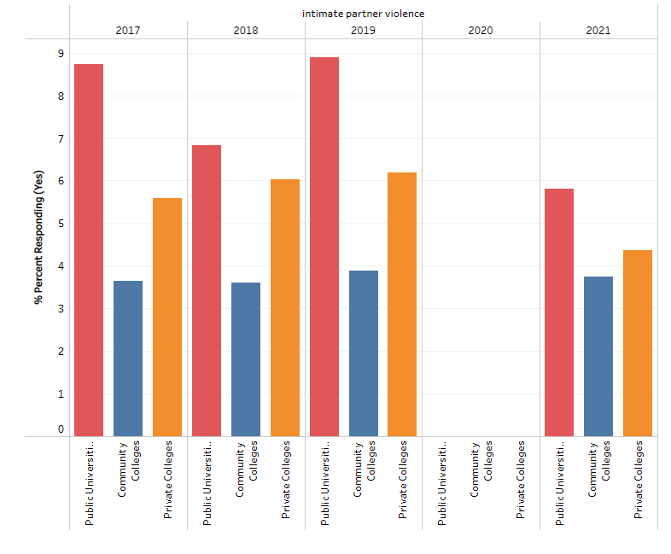
ODHE Data

Slide 25
Common Concerns in IPV Situations
Supportive measures are important to ensure the parties can be separate and feel safe
Retaliation is often a critical concern – parties may still have a relationship
Consider whether parties need contingency plans as part of their supportive measures if safety concerns arise
Balancing third-party reports of violence and safety concerns with complainant’s refusal to participate in the process
No contact order violations as continued evidence of underlying policy violation allegation
It is not uncommon for both parties to be complainants and respondents. Watch for this scenario and ensure you provide appropriate intake for both.

Slide 26
IPV: Questions
What is the relationship between the parties? Do they agree?
What is the act of violence described?
Under what circumstances did the act of violence occur?
If the situation involved mutual combat:
  Was one person the initiator and the other acting in self defense?
  Should an investigation be opened against the complainant as well?

Slide 27
Sexual Harassment:
Stalking
“Stalking” is engaging in a course of conduct directed at a specific person on the basis of sex that would cause a reasonable person with similar characteristics under similar circumstances to:
Fear for the person’s safety or the safety of others; or
Suffer substantial emotional distress.
As mentioned before, to qualify under Title IX, it must be sex-based stalking. (30172 fn. 772)
26
Notes:
If the stalking isn’t on the basis of sex, the institution must still have a policy that prohibits it and deals with it according to the procedures dictated in the Clery regulations.

Slide 28
Stalking: Course of Conduct
“Course of Conduct”
Under VAWA regulations: means two or more acts, including, but not limited to, acts in which the stalker directly, indirectly, or through third parties, by any action, method, device, or means, follows, monitors, observes, surveils, threatens, or communicates to or about a person, or interferes with a person's property.
27

Slide 29
Stalking: Reasonable Person
“Reasonable person”
Under VAWA regulations: means a reasonable person under similar circumstances and with similar identities to the victim.
28

Slide 30
Stalking: Substantial Emotional Distress
“Substantial emotional distress”
Under VAWA regulations: means significant mental suffering or anguish that may, but does not necessarily, require medical or other professional treatment or counseling.
29

Slide 31
Stalking Data
3.4 million individuals aged 16 or older (1.3%) were stalked during 2019. This represents a slight drop from 2016 (1.5%). Females were stalked more than twice as often as males.
1 in 6 women and 1 in 17 men have been stalked at some point in their lives.
Nearly 54% of female victims and 41% of male victims experienced stalking before the age of 25.
First statistic: U.S. Department of Justice, Bureau of Justice Statistics, “Stalking Victimization, 2019” published February 2022.
Second and third statistics: CDC “Preventing Stalking” fact sheet, accessed October 29, 2022.
30
Notes:
What do these data tell us about victims of stalking?

Slide 32
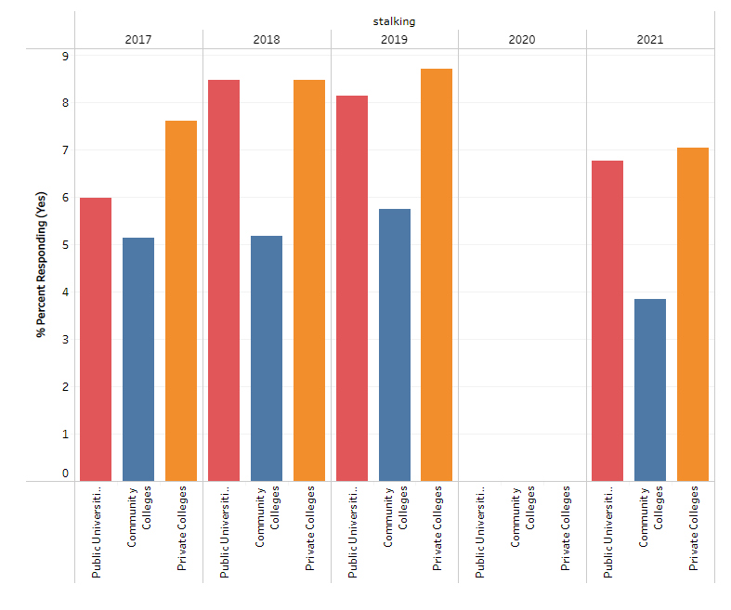
ODHE Stalking Data
31
Notes:
What do these data tell us about victims of stalking?

Slide 33
Impact of Stalking on Victims (1 of 2)
46% of stalking victims fear not knowing what will happen next.
[Baum et al., (2009). "Stalking Victimization in the United States." BJS.]
29% of stalking victims fear the stalking will never stop.
[Baum et al.]
67% of stalking victims in 2019 were fearful of being killed or physically harmed.
U.S. Department of Justice, Bureau of Justice Statistics, “Stalking Victimization, 2019” published February 2022.
32
Notes:
What do these data tell us about victims of stalking?

Slide 34
Impact of Stalking on Victims (2 of 2)
1 in 8 employed stalking victims lose time from work as a result of their victimization and more than half lose 5 days of work or more.
1 in 7 stalking victims move as a result of their victimization.
[Baum et al.]
The prevalence of anxiety, insomnia, social dysfunction, and severe depression is much higher among stalking victims.
[Eric Blauuw et al. "The Toll of Stalking," Journal of Interpersonal Violence 17, no. 1(2002):50-63.]
33
Notes:
What do these data tell us about victims of stalking?

Slide 35
Stalking: Common Concerns
Clearly defined no-contact orders can be helpful to keep the parties apart and help calm the situation.
Complainants are often concerned that the respondent may not respect no-contact orders, especially if they have already asked the respondent to stand down. Think of ways to help address this concern through supportive measures.
Stalking after a no contact order may constitute additional instances of the underlying alleged policy violation, which may mean you need to run it through your Title IX process.

Slide 36
Stalking: Considerations
Outline a timeline of the “course of conduct”
Cases are often documentation-heavy
May have multiple contacts and multiple witnesses that must be considered

Slide 37

Scenario Overview
Charlie and Jesse – Intimate Partner Violence?
Credibility Assessment Scenario

Slide 38
Outline of Evening
Dinner
Walk – Argument?
In the car – Violence?
Aftermath

Slide 39
Definition of Dating Violence
Violence committed by a person who is or has been in a social relationship of a romantic or intimate nature with the victim.
The existence of such a relationship shall be determined based on the reporting party’s statement and with consideration of the length of the relationship, the type of relationship, and the frequency of interaction between the persons involved in the relationship.

Slide 40
Brainstorm
What are the elements of dating violence?
What are the key things that will need to be decided to determine if a policy violation occurred?
What other things may help with a credibility assessment?

Slide 41

Conducting a Process That Protects and Holds Accountable

Slide 42







Overview of the Process
Report
Formal Grievance Process
Informal Resolution
Investigation
Hearing
Supportive Measures
Formal Complaint
Determination
Dismissal to
Other Procedures
Appeal
41

Slide 43
Split Roles
Team Charlie
Team Jesse
Panel & Volunteers
Need volunteers for three parts:
Complainant Charlie Chaste
Respondent Jesse Jacobs
Witness Whitney Wildcat

Slide 44

Three Roles: Three Spotlights
Notes:
The Hearing Panel is the middle spotlight – neutral light
The advisors are slanted – but help to fully illuminate the subject

Slide 45
Role: Hearing Panel Member
Reviews the evidence file, final investigation report, and responses of the parties
Considers what is missing, what is unclear, and what elements are disputed
Asks relevant questions at hearing, adjusting as other questions are asked
Is neutral in both the manner they act and the questions they asked

Slide 46
Hearing Panel Member: Your Goal
Have enough information on every element of every charge so that you can render a decision by a preponderance of the evidence
Have enough information to make decisions regarding the credibility of the parties and witnesses
Make relevancy determinations after every question asked by the advisors
Maintain decorum at all times, by all participants

Slide 47
Role: Advisor
Reviews the evidence file, final investigation report, and responses of the parties
Assists their party with preparation of relevant questions for hearing
  Goals is to assist the Decision-Makers with understanding the case from their party’s perspective
Asks relevant questions at hearing, adjusting as other questions are asked
Is not neutral, as the role is inherently biased towards their party, but still maintains decorum standards at all times

Slide 48
Advisors: Your Goal
The role of the advisor is to help the Panel understand your party’s perspective by:
Highlighting important evidence to help your party prove that the elements are met/not met
Highlighting discrepancies in the evidence that disprove the other party’s story
Highlighting credibility issues of the other party and witnesses where they are testifying against your party

Slide 49
How Do You Choose Questions?

Slide 50
What Don’t You Know?
Hearing Officers: If you need to know it to make a determination, you have the obligation to ask the question.
Advisors: If you don’t know the answer to the question before you ask it, it may harm your party. Weigh the benefits of asking carefully before proceeding.

Slide 51
What Do You Know?
Hearing Officers: It can be helpful to ask questions when you think you already know the answer, to ensure that you are able to sequence events correctly and that you understand nuances in the testimony.
Advisors: If the testimony is going to help tell your party’s story, it can be helpful to bring it to the forefront of the Hearing Officer’s mind.

Slide 52
Disputed Facts?
Hearing Officers: Question on disputed facts so that you can weigh credibility, make a determination, and explain your rationale.
Advisors: Highlight areas for the Hearing Officer where the other party’s story doesn’t make sense by asking questions to discredit the witness, or to provide corroborating evidence for your party’s story.

Slide 53
Make Your Plans
Hearing Officers:
  What themes do you wish to draw out?
  What disputed points do you need information on?
  Who will cover which topics?
  Which questions will be asked?
Advisors:
  Use this discussion to help frame your questions. What key points do you think need to be addressed with each witness to highlight your party’s story?
  What information is most critical of your party’s story, and what can help highlight the weaknesses in that information as compared to the strengths in your information?

Slide 54
Pick a Goal
Consider choosing a goal for yourself to try to reach through questioning:
  Advisor: “By questioning Sarah, I will try to show that Respondent was more aware of Complainant’s intoxication level than the report suggests.”
  Hearing Officer: “In questioning Complainant, I will try to better understand what effects she felt from her head injury versus intoxication.”
  Etc.

Slide 55
Remember: Credibility Factors
Credibility is determined based on a “totality of the circumstances.” Factors to consider:
  Witness statements
  Detail and consistency of accounts
  Corroborating evidence or the lack thereof, if it should logically exist
  Information about how the reporting person acted following the incident, both immediately and over time
  Information about whether the complainant told others about the incident soon after it occurred
  Other contemporaneous evidence of accounts
  Credible reports of similar incidents by the respondent (careful here!)
  Whether the reporting person has been shown to make false reports (again, careful here!)

Slide 56
Plan Your Strategy
Pick a goal for the questions you will ask
  Example: I will try to get Charlie to admit that the bruise could have been from something else.
Coordinate among team members to ensure goals cover the key points in the case

Slide 57
Mock Hearing

Slide 58

How to Make a Good Decision
Use your Policy and Follow your Process

Slide 59
Reminders (1 of 3)
Individual cases are not about statistics
Decision in every case must be based on preponderance of evidence or clear and convincing evidence presented
Cannot fill in evidentiary gaps with statistics, personal beliefs or information about trauma
Process must be fair and impartial to each party
Institution may proceed without active involvement of one or both parties; base conclusions on impartial view of evidence presented

Slide 60
Reminders (2 of 3)
Withhold pre-judgment: The parties may not act as you expect them to
Be aware of your own biases as well as those of the complainant, respondent, and witnesses
Let the available facts and standard of proof guide your role in overseeing the live cross-examination hearing, not unfair victim-blaming or societal/personal biases

Slide 61
Reminders (3 of 3)
Burden of gathering the evidence on the recipient, not the parties (30333)
  Don’t penalize a party for the questions no one asked them.

Slide 62
Objectively Evaluating Relevant Evidence
As addressed in the preamble and discussed earlier, the Hearing Officer should evaluate:
“consistency, accuracy, memory, and credibility (30315)
“implausibility, inconsistency, unreliability, ulterior motives, and lack of credibility” (030330)
Standard of proof and using it to guide decision
Notes:
Expect the unexpected and roll with it
Unexpected examples:
Party shows up but says they have to leave in the middle
Respondent “shushes” the hearing officer

Slide 63
Standard of Proof
Standard of Evidence: Preponderance of the Evidence
  Use this standard to make every factual determination!
Must begin with a presumption of no violation by Respondent.
If the case is truly “50-50,” the tie goes to the Respondent.

Slide 64
Making credibility decisions
The preamble discussion includes the following additional information on credibility:
“Studies demonstrate that inconsistency is correlated with deception” (30321)
Credibility decisions consider “plausibility and consistency” (30322)

Slide 65
Resolving Disputes (1 of 4)
OCR 2001 Guidance recommends considering the following when resolving the conflict:
Statements by any witnesses to the alleged incident (Regs: only when subjected to cross-examination)
Evidence about the relative credibility of the complainant/respondent
The level of detail and consistency of each person’s account should be compared in an attempt to determine who is telling the truth
Is corroborative evidence lacking where it should logically exist?
Notes:
Remember, 2001 Guidance still good where not inconsistent with Regs

Slide 66
Resolving Disputes (2 of 4)
OCR 2001 Guidance recommends considering the following when resolving the conflict and consistent with Regulations:
Evidence of the complainant’s reaction or behavior after the alleged harassment
Were there witnesses who saw that the complainant was upset?
Changes in behaviors? Work-related? School? Concerns from friends and family? Avoiding certain places?
May not manifest until later

Slide 67
Resolving Disputes (3 of 4)
OCR 2001 Guidance recommends considering the following when resolving the conflict and consistent with Regulations:
Evidence about whether the complainant filed the complaint or took other action to protest the conduct soon after the alleged incident occurred
But: failure to immediately complain may merely reflect a fear of retaliation, a fear that the complainant may not be believed, etc. rather than that the alleged harassment did not occur

Slide 68
Resolving Disputes (4 of 4)
OCR 2001 Guidance recommends considering the following when resolving the conflict:
Other contemporaneous evidence:
Did the complainant write about the conduct and reaction to it soon after it occurred (e.g. in a diary, email, blog, social media post)?
Did the student tell others (friends, parents) about the conduct and their reaction soon after it occurred?
Again, only if subjected to cross-examination

Slide 69
#1 Keep An Open Mind
Keep an open mind until all statements have been tested at the live hearing
Don’t come to any judgment, opinion, conclusion or belief about any aspect of this matter until you’ve reviewed or heard all of the evidence AND consider only the evidence that can remain (statements in the record might have to be removed from consideration if not tested in live-hearing)

Slide 70
#2 Sound, Reasoned Decision
You must render a sound, reasoned decision on every charge
You must determine the facts in this case based on the information presented
You must determine what evidence to believe, the importance of the evidence, and the conclusions to draw from that evidence

Slide 71
#3 Consider All/Only Evidence
You must make a decision based solely on the relevant evidence obtained in this matter and only statements in the record that have been tested in cross-examination
You may consider nothing but this evidence

Slide 72
#4 Be Reasonable and Impartial
You must be impartial when considering evidence and weighing the credibility of parties and witnesses
You should not be swayed by prejudice, sympathy, or a personal view that you may have of the claim or any party
Identify any actual or perceived conflict of interest

Slide 73
#5 Weight of Evidence
(1 of 2)
The quality of evidence is not determined by the volume of evidence or the number of witnesses or exhibits.
It is the weight of the evidence, or its strength in tending to prove the issue at stake that is important.
You must evaluate the evidence as a whole based on your own judgment.

Slide 74
#5 Weight of Evidence
(2 of 2)
Decision-makers who are trained to perform that role means that the same well-trained decision-maker will determine the weight or credibility to be given to each piece of evidence, and how to assign weight (30331)

Slide 75
#6 Evaluate Witness Credibility
(1 of 3)
You must give the testimony and information of each party or witness the degree of importance you reasonably believe it is entitled to receive.
Identify all conflicts and attempt to resolve those conflicts and determine where the truth (standard or review/proof) lies.

Slide 76
#6 Evaluate Witness Credibility
(2 of 3)
Consider the reasonableness or unreasonableness, or probability or improbability, of the testimony.
Does the witness have any motive?
Is there any bias?

Slide 77
#6 Evaluate Witness Credibility
(3 of 3)
Credibility is determined fact by fact, not witness by witness
The most earnest and honest witness may share information that turns out not to be true

Slide 78
#7 Draw Reasonable Inferences
Inferences are sometimes called “circumstantial evidence.”
It is the evidence that you infer from direct evidence that you reviewed during the course of reviewing the evidence.
Inferences only as warranted and reasonable and not due to decision to opt out of cross-examination or questioning.

Slide 79
#8 Standard of Evidence
(1 of 2)
Use your standard of evidence as defined by your policy when evaluating whether someone is responsible for each policy violation and ALWAYS start with presumption of no violation.
Preponderance of the evidence: a fact is more likely than not to be true (30373 fn. 1409)
Clear and convincing: a fact is highly probable to be true (30373 fn. 1409)

Slide 80
#8 Standard of Evidence (2 of 2)
Look to all the evidence in total, and make judgments about the weight and credibility, and then determine whether or not the burden has been met.
Any time you make a decision, use your standard of evidence

Slide 81
#9 Don’t Consider Impact
Don’t consider the potential impact of your decision on either party when determining if the charges have been proven.
Focus only on the charge or charges brought in the case and whether the evidence presented to you is sufficient to persuade you that the respondent is responsible for the charges.
Do not consider the impact of your decision.

Slide 82

Writing the Decision
Show your work, and get credit for your good thinking!

Slide 83
Written Determination in 106.45(b)(7)(ii) (1 of 9)
Written determination must include:
Identification of the allegations potentially constituting sexual harassment;
A description of the procedural steps taken from the receipt of the formal complaint through the determination, including any notifications to the parties, interviews with parties and witnesses, site visits, methods used to gather other evidence; and hearings held;

Slide 84
Written Determination in 106.45(b)(7)(ii) (2 of 9)
Include key elements of any potential policy violation so parties have a complete understanding of the process and information considered by the recipient to reach its decision (30391) – should “match up” with decision (30391)

Slide 85
Written Determination in 106.45(b)(7)(ii) (3 of 9)
Purpose of key elements of procedural steps “so the parties have a thorough understanding of the investigative process and information considered by the recipient in reaching conclusions.” (30389)

Slide 86
Written Determination in 106.45(b)(7)(ii) (4 of 9)
A statement of, and rationale for, the results as to each allegation, including determination regarding responsibility, any disciplinary sanctions the recipient imposes on the respondent, and whether remedies designed to restore or preserve equal access to the recipient’s education program or activity will be provided by the recipient to the complainant; and
Notes:
How does your institution intend to address this requirement?

Slide 87
Written Determination in 106.45(b)(7)(ii) (5 of 9)
Statement of rationale: requiring recipients to describe, in writing, conclusions (and reasons for those conclusions) will help prevent confusion about how and why a recipient reaches determinations regarding responsibility (30389)
The requirement of “Transparent descriptions of the steps taken in an investigation and explanations of the reasons why objective evaluation of the evidence supports findings of facts and conclusions of facts” helps prevent injection of bias (30389)

Slide 88
Written Determination in 106.45(b)(7)(ii) (6 of 9)
Institution’s procedures and permissible bases for complainant and respondent to appeal
Provided to both parties in writing contemporaneously (106.45(b)(7)(ii))

Slide 89
Written Determination in 106.45(b)(7)(ii) (7 of 9)
Receiving decision simultaneously will ensure both parties have relevant information about the resolution of the allegations

Slide 90
Written Determination in 106.45(b)(7)(ii) (8 of 9)
Reference to code of conduct not prohibited:
“Recipients retain discretion to also refer to in the written determination to any provision of the recipient’s own code of conduct that prohibits conduct meeting the [Title IX definition] of sexual harassment; however” the final regulations apply to recipient’s response to Title IX portion only. (30389)

Slide 91
Written Determination in 106.45(b)(7)(ii) (9 of 9)
The preamble discussion notes that it does not “expressly require the written determination to address evaluation of contradictory facts, exculpatory evidence, all evidence presented at a hearing, or how credibility assessments were reached, because the decision-maker is obligated to objectively evaluate all relevant evidence, including inculpatory and exculpatory evidence (and to avoid credibility inferences based on a person’s status as a complainant, respondent, or witness.”
Note: Consider including these anyway for a more thorough determination.

Slide 92

Finalizing Our Case
How Do We Decide?

Slide 93
Making OUR Decision
Questions to consider:
  Were they dating at the time of the incident?
  Did Jesse grab Charlie’s arms?
    If so, was this “violence”?
  Did Jesse slap Charlie’s face?
    If so, was this “violence”?

Slide 94
If you are having trouble
Consider making a list of what you are sure about that relates to the question you are considering.
Make a list of what facts are disputed.
Focus on resolving the disputed facts by a preponderance of the evidence.
When you have the facts decided, the policy language should be much easier to apply.

Slide 95
Additional information available at:
Title IX Resource Center at www.bricker.com/titleix
Free upcoming webinars at www.bricker.com/events
Find us on Twitter at @BrickerHigherEd

